Slide 1
Smart Eco System Client Pitch
Prepared By TEAM DDNS
Dorota Marczak, Nader Sobhi, Declan Bell and Scott Allan
Abertay University
23.10.2018

Slide 2
PRODUCT BRIEF
The Client
Lynsey Shepard of Abertay Plant System to build a IoT plant monitoring system - build this out
The Brief
Build an inexpensive alternative to current products
Collect data on the plants environment
Provide a graphical representation of the data collected

Slide 3
What Will Be Covered In The Talk?
-The client requirements and how we will meet them
- How we will build the Monitoring System
- How we approached the project
- Potential risks
- Potential benefits/costs
- Reflection on project

Slide 4
Clients Requirements
Gather sensor data from plant:
- Temperature
- Light
- Moisture
- Humidity
Collect data into Database
Present data in a graphical manner on website
Ability to produce device commercially
Easy set-up of device

Slide 5
Meeting Client Requirements
In order to meet the client requirements, the following will be done:
Use an Arduino UNO paired with a WEMOS board to collect data from sensors
Push the data collected from the hardware to a database
Create a web portal that dynamically graphs data
Devices will be very easy to manufacture en-masse
Device will be easy to setup

Slide 6
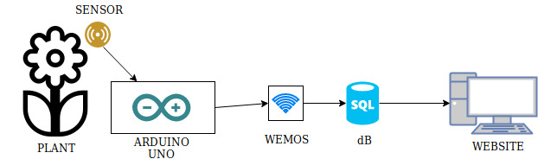
The Build
- Plant: TBD
- Sensor: Light, Temperature, Moisture, Humidity
- Arduino Uno: Collects information from sensors
- WEMOS: Provides internet connectivity & data routing
- Database: Holds collected data
- Website: Displays collected information

Slide 7
Project Approach
In order to complete this project the following is required:
Created project plan
Test feasibility of desired outcome
Regular consultations with client – improvements or concerns
Produce necessary project documentation
Develop prototype – hardware and performance testing
Share notice board with the client

Slide 8
Methodology
Agile
- Communication and collaboration
- Functioning software
- Team self organization
- Adaptable
Scrum
- Values real-world results rather than speculation
- Sprints break down work into 'chunks', continuous improvement
Test Driven Development
- Refine product based on test results

Slide 9
Deliverables
Executive Summary
Cost breakdown
A prototype will be showcased to the client throughout development
Results from performance testing
User manual and other required documentation
Final product will contain a hardware device, website and database

Slide 10
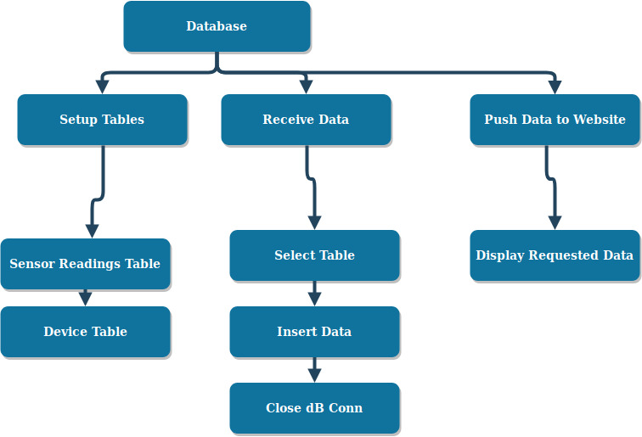
Work Breakdown Structure: dB

Slide 11
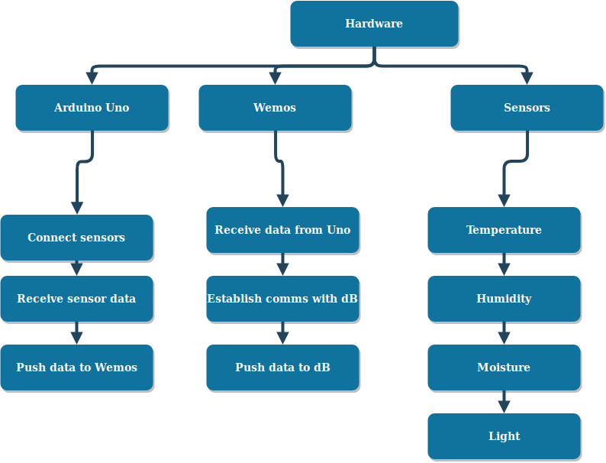
Work Breakdown Structure: Hardware

Slide 12
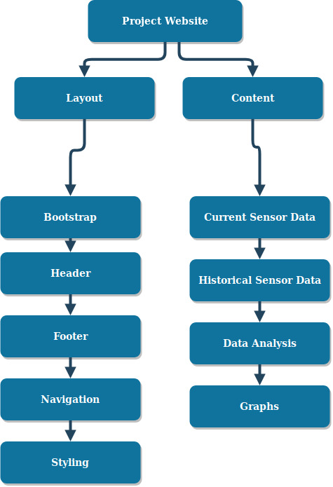
Work Breakdown Structure: Website

Slide 13
Risks
Exceed predetermined budget
- Use only resources needed
Inconsistent staff availability
- Overlap responsibilities
Technology in use becoming obsolete
- Research current/upcoming developments
Data Protection Regulation changing
- Remain informed of current legislation and any upcoming developments
Competitor creating alternative solution
- Ensure we have lowest cost/most versatile product
Delay in delivering final product
- Ensure work schedule is managable and project goal is achievable

Slide 14
Benefits
A device that will be used as a prototype that will be produced commercially
A reputation for fine IoT device production
Low cost of production
Easy to produce
Easy to advertise due to the fact the product is suitable for multiple use cases
Low maintenance costs
Be part of the Open Source Community

Slide 15
Costs
The hardware needed
The maintenance of the production line
The database and web hosting
Potential commercial licences

Slide 16
Going Forward
Ensure continued communication with the client
Better inter-team communication
More detailed description of working processes
Better software development methodologies

Slide 17
Thanks For Listening
We will now field any questions...

